Slide 1
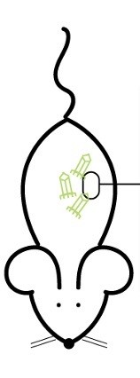
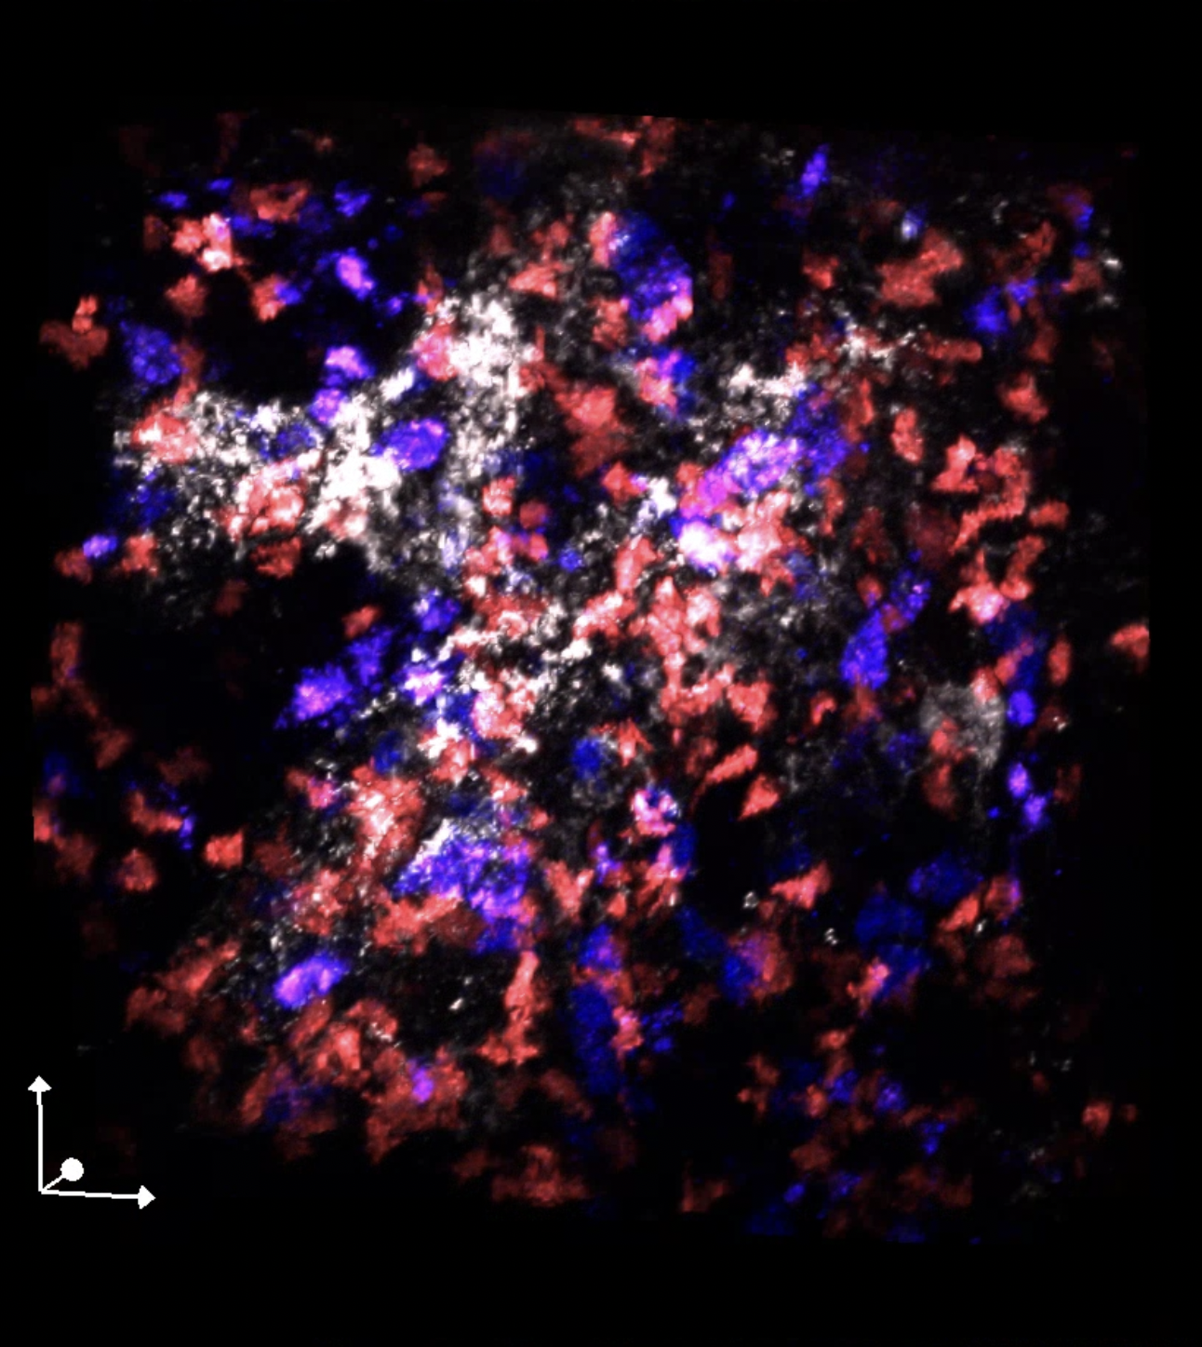
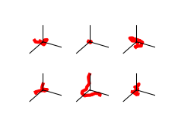
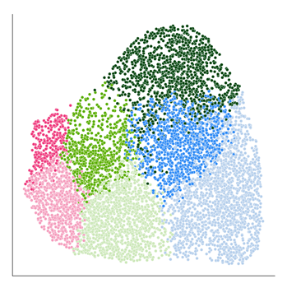
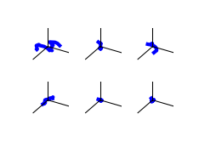
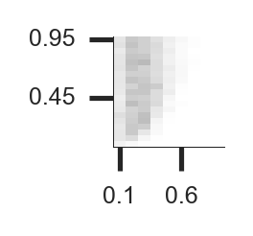
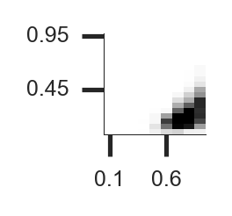
1
2
3
7
Measured Trajectories
Feature Extraction
Motility Quantification
Interaction Quantification
t=0m
Exp
Type
Features
MB7
Measure density of labelled GCBs and Tfhs.
5
9
Intravital imaging
1
MB1
Measure labelled GCB Tfh interactions
Explore
3
6
25µm
…
2
4
7
FDC T-cell B-cell
Input
Directly comparable
Compare output
TP
MP
TP
Features
TP
3D Simulation
MP
Find [MP, TP] that generate simulated trajectories closest to experimental ones
Run simulation with matching density of GCBs and Tfhs
y
TP
…
Predict GCB-Tfh interactions
Systematically quantify how motility behaviors drive
cell-cell interactions
z
x
MP
MP
4
5
6
8
Simulated Trajectories
Feature Extraction
Parameterization
Validation

Slide 2
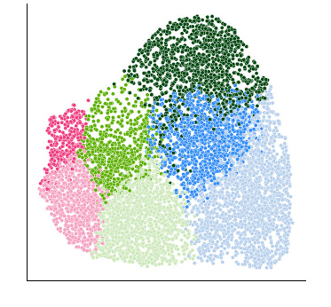
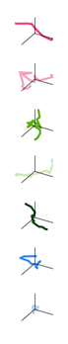
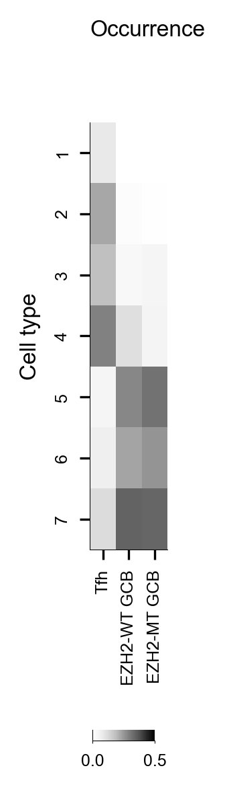
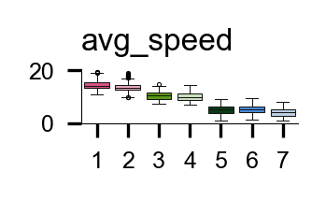
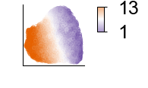
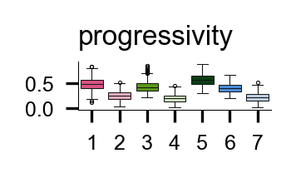
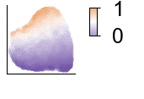
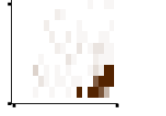
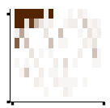
1) Data-driven modeling to quantify emergent, lymphocyte motility behaviors
A
B
D
Occurrence
Intravital time-lapse imaging
Motility behaviors (k=7)
1
t=0m .. t=10m
1
2
25µm
3
FDC T-cell B-cell
4
2
Feature extraction
C
5
Angle
Features
6
Displacement
7
Progressivity (Net : Total distance)
…
Tfh
Unsupervised clustering
WT
GCB
MT
GCB
3
E
2) Agent-based simulation to recapitulate learned, single-cell behaviors
Run ABM
Simulated Trajectories
Compare with Experiment
Optimize (MP, TP)
1
2
3
4
TP
B1
B1
1
B7
0.9
B7
TP
MP
0
TP
0
1
MP
0
MP
0.95
Run ABM for (MP,TP) over (0,1)
Trajectories with distinct (MP,TP)
Find distance to experimental trajectories
Optimized (MP,TP) distribution for each MB.

Slide 3
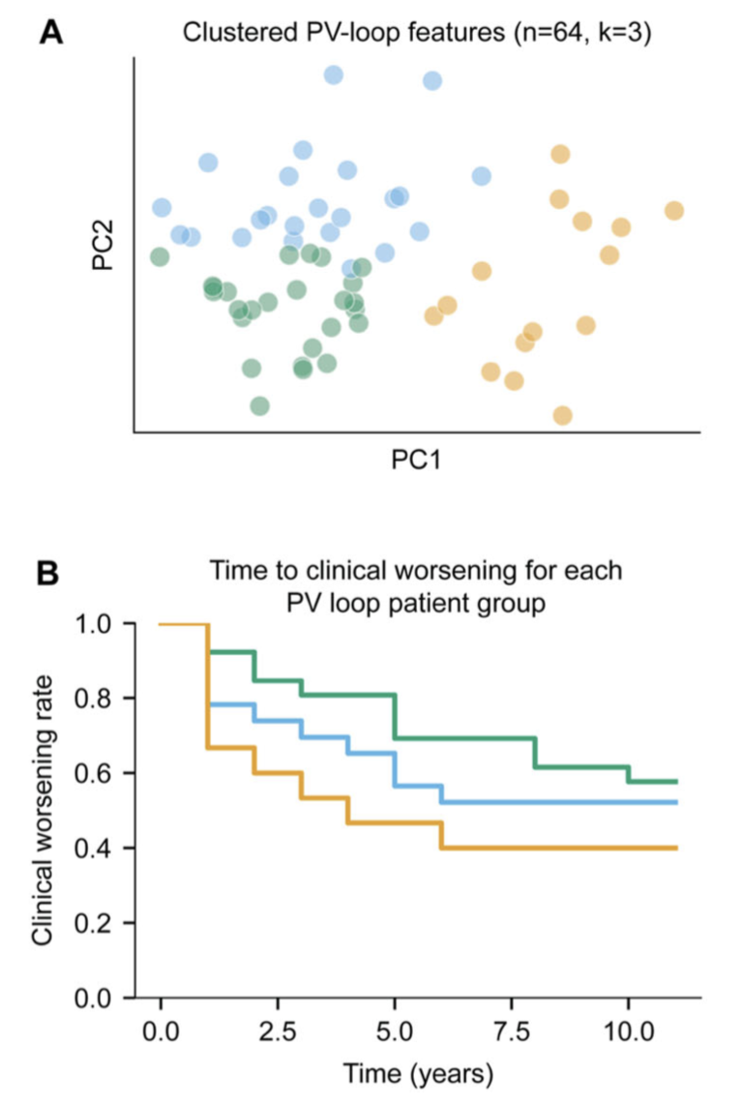
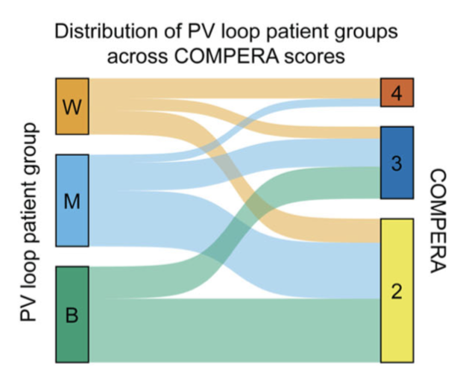
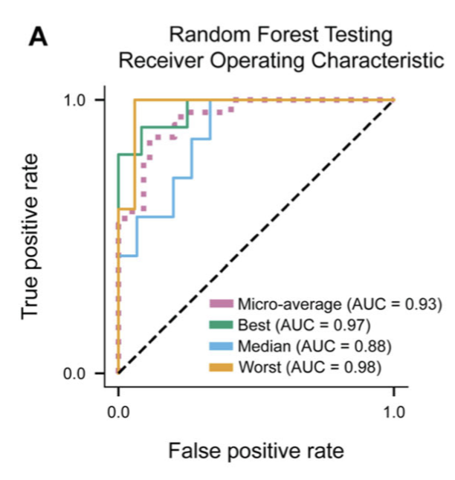
A
C
B
D

Slide 4
